Slide 1
TRUMP AND PRESIDENTS
By: Parthiv Borgohain, Anthony Moreno, Jason Nania, Nicole Pham-Nguyen, Kyle Tobia

Slide 2
PROBLEM STATEMENT
Perform analyses to identify differences in former President Trump's speeches compared to other presidents, i.e. how was he distinct from other presidents?
Notes:
Kyle

Slide 3

SOURCES AND PRE-PROCESSING
SOURCE:
TOKENIZE:
Presidential Speech Archive from the Miller Center at UVA
Tokenized in order to perform sentiment analysis
SCRAPE:
FREQUENCY COUNT:
Scraped and pulled 1033 speeches, ~21 speeches per president
Most common words: states, united, people, one, government
SUBSET:
NO STOPWORDS:
Removed stopwords such as "a", "is", "the"
Selecting only most recent 5 presidents for topic modeling
Notes:
Kyle

Slide 4
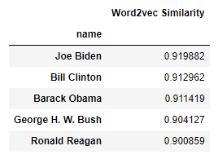
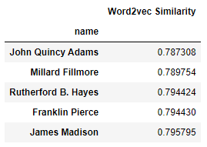
SIMILARITY ANALYSIS
Performing a SpaCy NLP similarity analysis using large pre-trained word vectors to compare former president Trump’s speeches with speeches from all other presidents yielded the following takeaways:
The president whose speeches are closest to Trump’s is Joe Biden
The president whose speeches are furthest to Trump’s is John Quincy Adams
Looking at the most common words between Trump and Biden, we see similar words like ‘country’, ‘world’, ‘people’, and ‘time’
Adams uses words that are much less common in contemporary speeches, like 'upon', 'intercourse', 'principles', and ‘shall’
Notes:
As the further back we go in time, the less similar a speech given by a president is likely to be to a speech given by Trump because both the everyday vernacular and the issues of the time have changed
Anthony

Slide 5
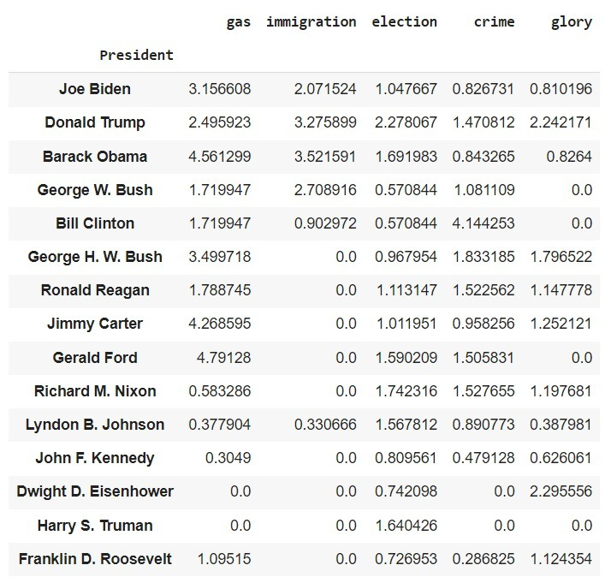
LIFT ANALYSIS
Notes:
Nicole
The most frequent words were not helpful and neither were Trump's most common words, so we looked at words that are very commonly associated with phrases and words he's known to say
Glory is as high as Eisenhower
Immigration, and election are very high
Crime is almost as high as Clinton (Monica Lewinsky) and George H.W. Bush
Gas is surprisingly not as high as other presidents, but that might be because his presidency was during COVID-19 so that was the biggest topic at the time

Slide 6
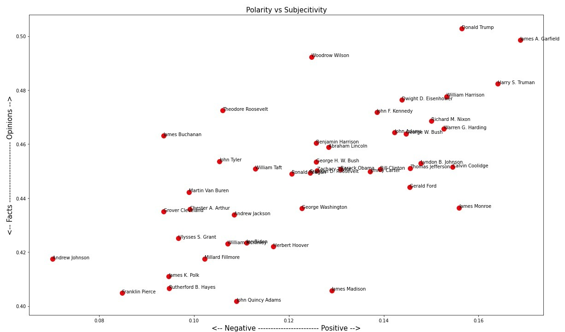
POLARITY VS. SUBJECTIVITY PLOT
Notes:
Jason

Slide 7
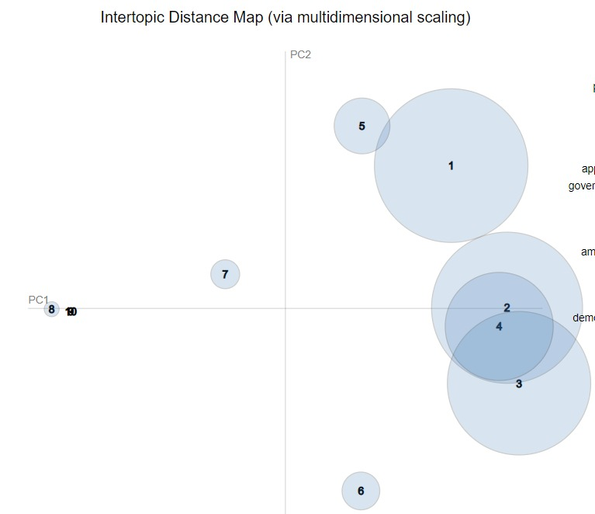
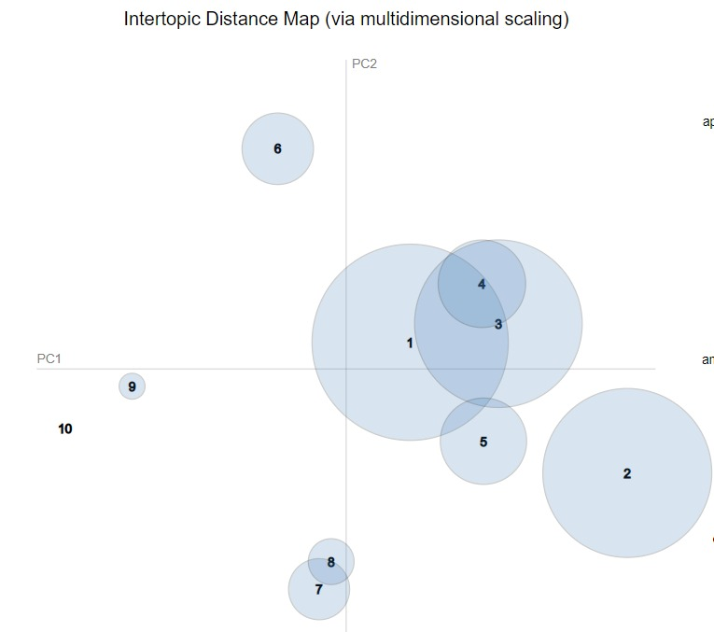
TOPIC MODELLING
Joe Biden to Bill Clinton
Donald Trump
Topics of Interest-
Topic 5: War
Topic 6: Taxes & Economy
Topic 7: Crime
Topic 8: Space
Topics of Interest-
Topic 6: Nationalism
Topic 7: Covid-19
Topic 8: Immigration
Topic 9: Terrorism
Notes:
Parthiv

Slide 8
INSIGHTS
Similarity Analysis: Shows that modern speeches are more alike and older speeches are more alike
Trump talks about the same topics compared to his 3 predecessors and the current president
There is little to no difference across party lines with regard to speech similarity, rather the factor that determines speech similarity the most are the topics or issues of the time
Lift Matrix: Trump's speeches show a lot of information for these specific opinionated topics compared to his peers
Polarity vs. Subjectivity Plot: Shows that modern presidents are centered for polarity vs. subjectivity
Trump is an outlier in both polarity and subjectivity
Topic Modelling:
Past 5 former topics: war, taxes and economy, crime, and space
Trump's topics: nationalism, COVID-19, immigration, terrorism
Notes:
Nicole
Overall, Trump's speeches do hold some distinctness compared to modern presidents that could be a reason why his followers are very fanatic compared to other presidents. From our analysis, Trump tends to speak more freely compared to other presidents and incorporates a lot of American pride in his speeches. This can be seen from his high lift scores for hot-button topics and patriotism-inducing words, high polarity and subjectivity scores compared to the other modern presidents, and his differing hot-button topics such as nationalism, immigration, and terrorism.

Slide 9
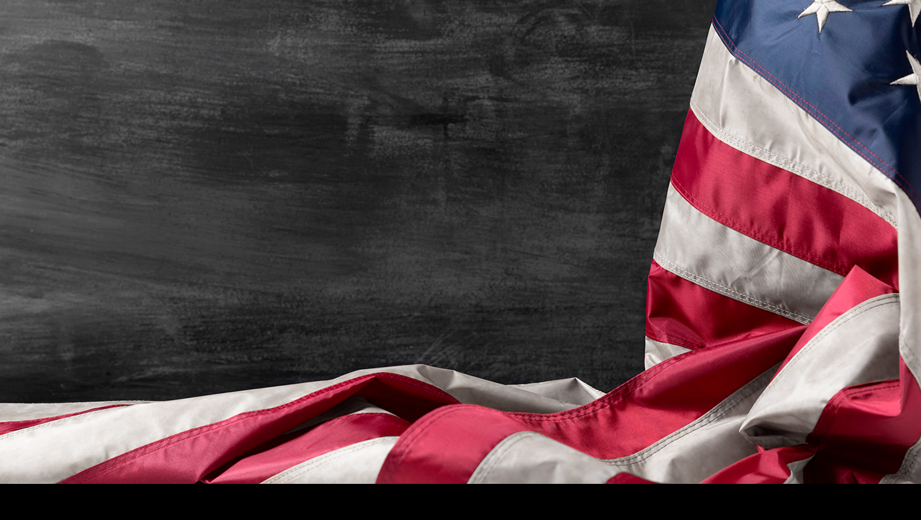
THANK YOU!
QUESTIONS?

